Slide 1
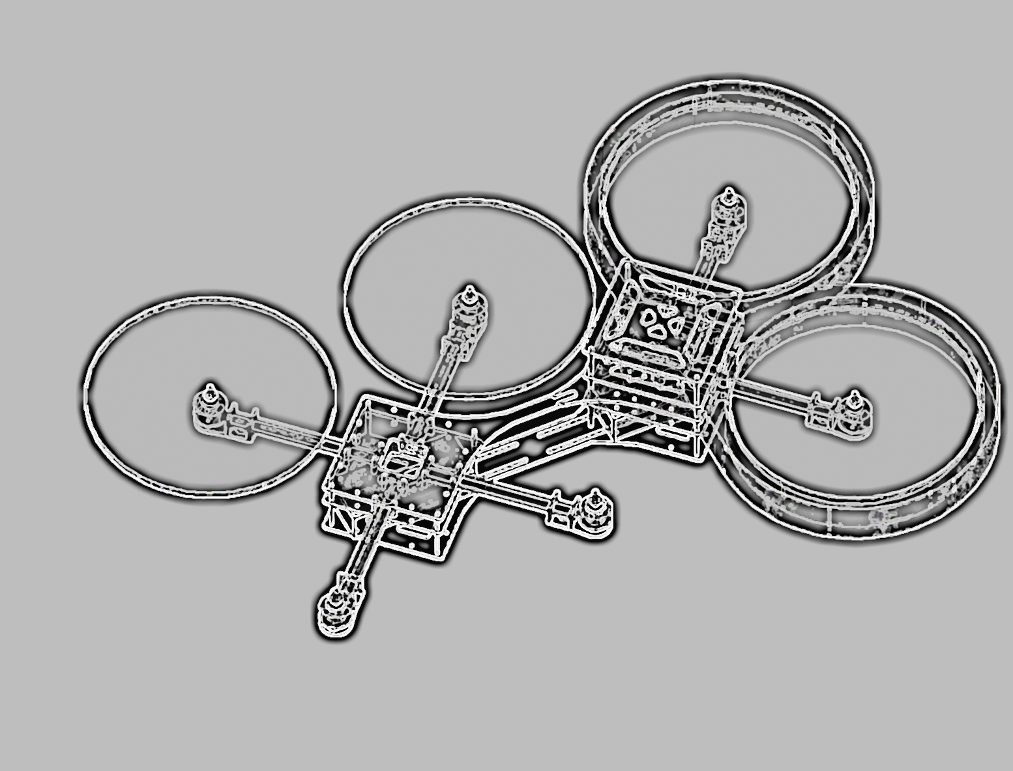
Integrated Project
X-COPTER

Slide 2

The X-Copter Project: Challenges
University of
Applied Sciences
Linux
Underestimated the complexity
Implementation of WIFI
USB Controller
MAVLINK & MCAPI

Slide 3
The X-Copter Project: Challenges
University of
Applied Sciences
General Challenges & Problems
Organizing the team
Time Management
File Management
NIOS Eclipse doesn‘t work with git
SCRUM

Slide 4
The X-Copter Project: Topic
University of
Applied Sciences
Improvement
Initial state | Actual state
Wrong USB Hardware | No USB Controller
Power supply doesn‘t work | Power supply works
No test flight | xCopter flies
- | In principle connection to ground station established
- | Working concept with our own flight controller

